Slide 1
African influencers: Twitter users segmentation
Amure Ridwan

Slide 2
Outline
Introduction
Aim of this research
Methodology
Result
Recommendation

Slide 3
Introduction
Why Influencer marketing
Aim of this research work

Slide 4
Aim of this research
Objective of this research

Slide 5
Methodology
Parameters to consider
Metrics to use

Slide 6
Result
Parameter for consideration
Metric
Influencer | reach | Popularity
gettleman | 25666 | 1336
a24media | 28227 | 48
andiMakinana | 98420 | 2550
AfricaCheck | 63479 | 929
JamesCopnall | 16913 | 61
oafrica | 28417 | 321
PatrickNgowi | 22619 | 543
StateAfrica | 8 | 0
Moadow | 49256 | 70
Table 1: Matric score for selected African Influencers

Slide 7
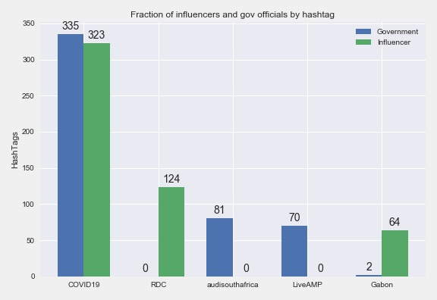
Result continued
Figure 1: Hashtags contributed to by African Influencers and Government

